Slide 1
CSE/PC/B/T/316 Computer Networks Class Test 1
Sarbani Roy
sarbani.roy@jadavpuruniversity.in
Office: CC-5-7
Cell: 9051639328

Slide 2

Q1: Consider a pure ALOHA network transmits 100 bits frame on a shared channel of 100 Kbps. How many frames has to be sent by a station so that 1.35 frames will be sent successfully in 10 seconds? Assume there are 100 stations.
Options:
$≈10$
$≈100$
$≈110$
$≈90$

Slide 3

Solution
$T_{fr}=\frac{100 bits}{100000 bps}=1ms$
$G=100×\left(\frac{n}{10}\right)×1ms=\frac{n}{100}$
$Throughput=S=\frac{1.35}{10}=0.135=G×e^{−2G}$
If G=1, then S=0.135
Hence, $\frac{n}{100}=1$
$n=100$

Slide 4
Q2: Following are 5 Ethernet address in hexadecimal notation: (i) 5A:42:12:10:2A:14 (ii) 37:22:45:1B:07:EA (iii) 5E:1A:2B:21: 32:EE (iv) AB:42:1C:E1:EE:1A (v) 44:2A:5C:EE:10:E1. Now, which of these addresses cannot be used as source address in Ethernet frame.
Options:
(i)&(iii)
(iii)&(iv)
(ii)&(iv)
(ii)&(iii)

Slide 5
Solution

Slide 6
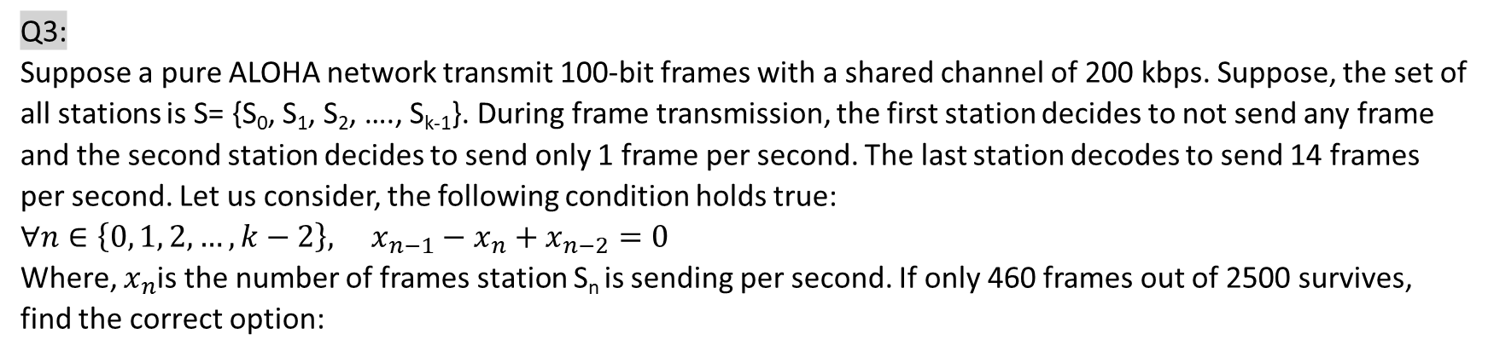
Q3: Suppose a pure ALOHA network transmit 100-bit frames with a shared channel of 200 kbps. Suppose, the set of all stations is S= {S₀, S₁, S₂, …., S_{k-1}}. During frame transmission, the first station decides to not send any frame and the second station decides to send only 1 frame per second. The last station decodes to send 14 frames per second. Let us consider, the following condition holds true: $∀n∈\left\{0, 1, 2,…, k−2\right\}, x_{n−1}−x_{n}+x_{n−2}=0$ Where, $x_{n}$is the number of frames station S_{n} is sending per second. If only 460 frames out of 2500 survives, find the correct option:
Option
k= 14
k=15
k=17
k=18

Slide 7
Solution:
Frame transmission time=100/200kbps=1/2ms
Throughput = 460/2500= 0.184
Max throughput achieved when G=1/2
If we consider k=15 then,
Total numbers of frames all stations create per second = 0+1+1+2+3+5+8+13+21+34+55+89+144+233+377+14=1000
1 sec i.e. 1000ms ………………….1000 frames
1ms ………………………………………1 frame
½ ms …………………………………….1/2 frame
G=Avg No of frames transmitted during 1 frames transmission time=1/2

Slide 8
Q4: Suppose that a group of 20 stations is serviced by an Ethernet LAN. If all these stations are connected to 1000 Mbps switch then how much bandwidth is available to each station?
Options:
50 Mbps
1000 Mbps
10 Mbps
100 Mbps

Slide 9
Solution:
Ans= 1000 Mbps
Since all stations can make use of 1000 Mbps available bandwidth.

Slide 10
Q5. Suppose we have a standard Ethernet with 10 Mbps transmission rate. The medium length is 2500 m. Also consider a packet size of 2¹⁰ bits out of which 240 bits represents overhead. If propagation speed is 2.3 x 10⁸ m/sec. Find the throughput.
Options
5.9 Mbps
5.5 Mbps
6.2 Mbps
None of the above

Slide 11
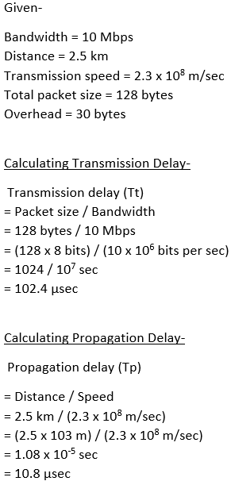
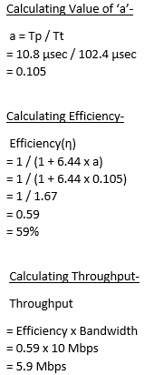
Solution:

Slide 12
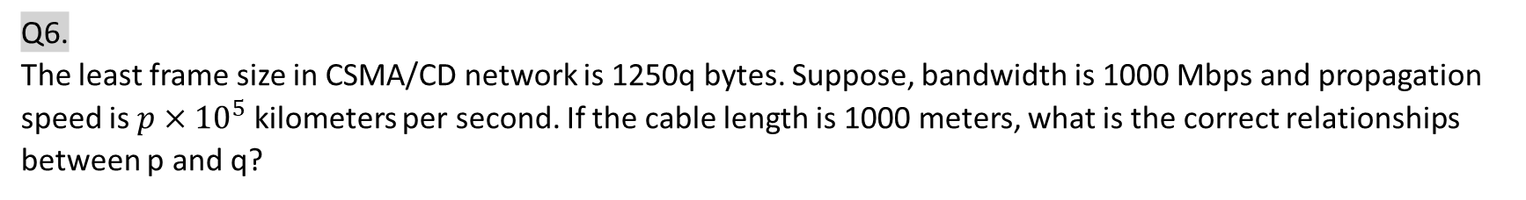

Q6. The least frame size in CSMA/CD network is 1250q bytes. Suppose, bandwidth is 1000 Mbps and propagation speed is $p×{10}^{5}$ kilometers per second. If the cable length is 1000 meters, what is the correct relationships between p and q?
Options:
$\log_{2}{p}=1+\log_{2}{q}$
$\log_{2}{p}=1−\log_{2}{q}$
$\log_{e}{p}=1−\log_{e}{q}$
None of the above

Slide 13

Solution:
$T_{d}=\frac{distance}{propagation speed}$
$S=2×bandwidth×T_{d}$
$1250×q×8=\frac{2×{10}^{9}×1000}{p×{10}^{8}}$
$p=\frac{2}{q}$
$pq=2$
$\log_{2}{pq}=1$
$\log_{2}{p}+\log_{2}{q}=1$
$\log_{2}{p}=1−\log_{2}{q}$

Slide 14
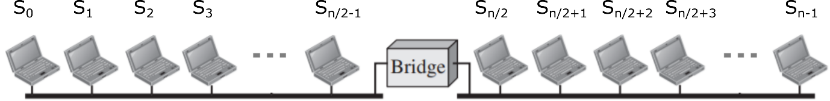
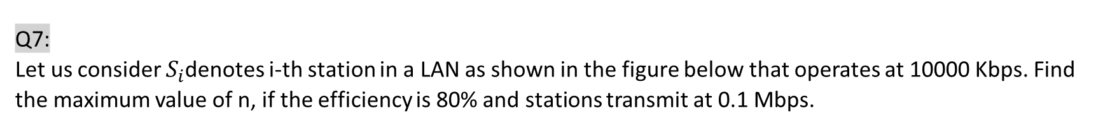
Q7: Let us consider $S_{i}$denotes i-th station in a LAN as shown in the figure below that operates at 10000 Kbps. Find the maximum value of n, if the efficiency is 80% and stations transmit at 0.1 Mbps.
Options:
159
160
158
79

Slide 15

Solution:
Max no of stations = $\frac{\left(10000 Kbps ×0.8\right)×2}{100 Kbps}=160$
Max value of n=160

Slide 16
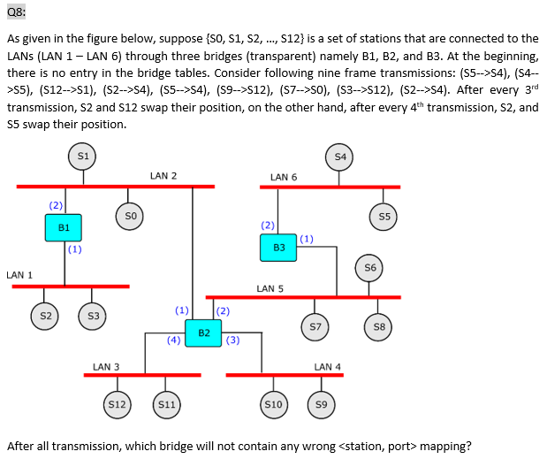
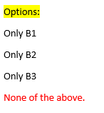

Slide 17
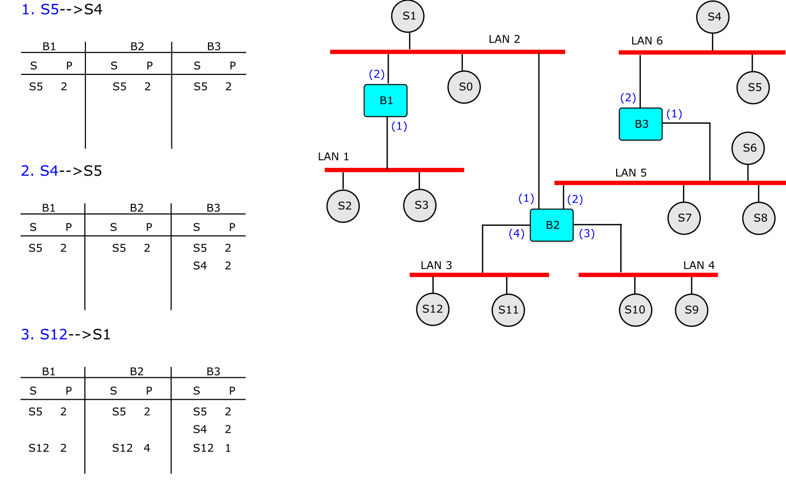

Slide 18
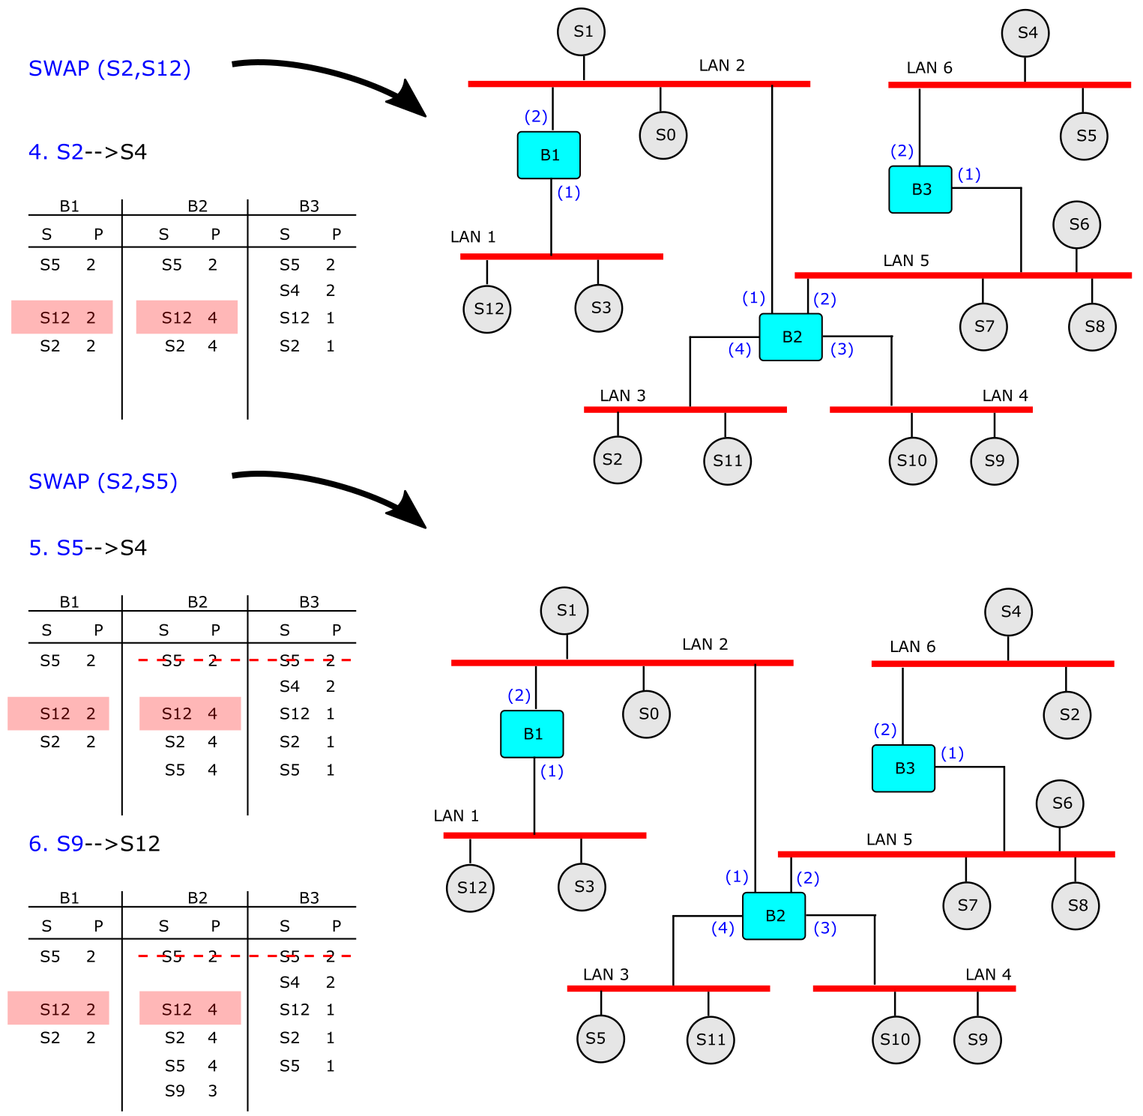

Slide 19
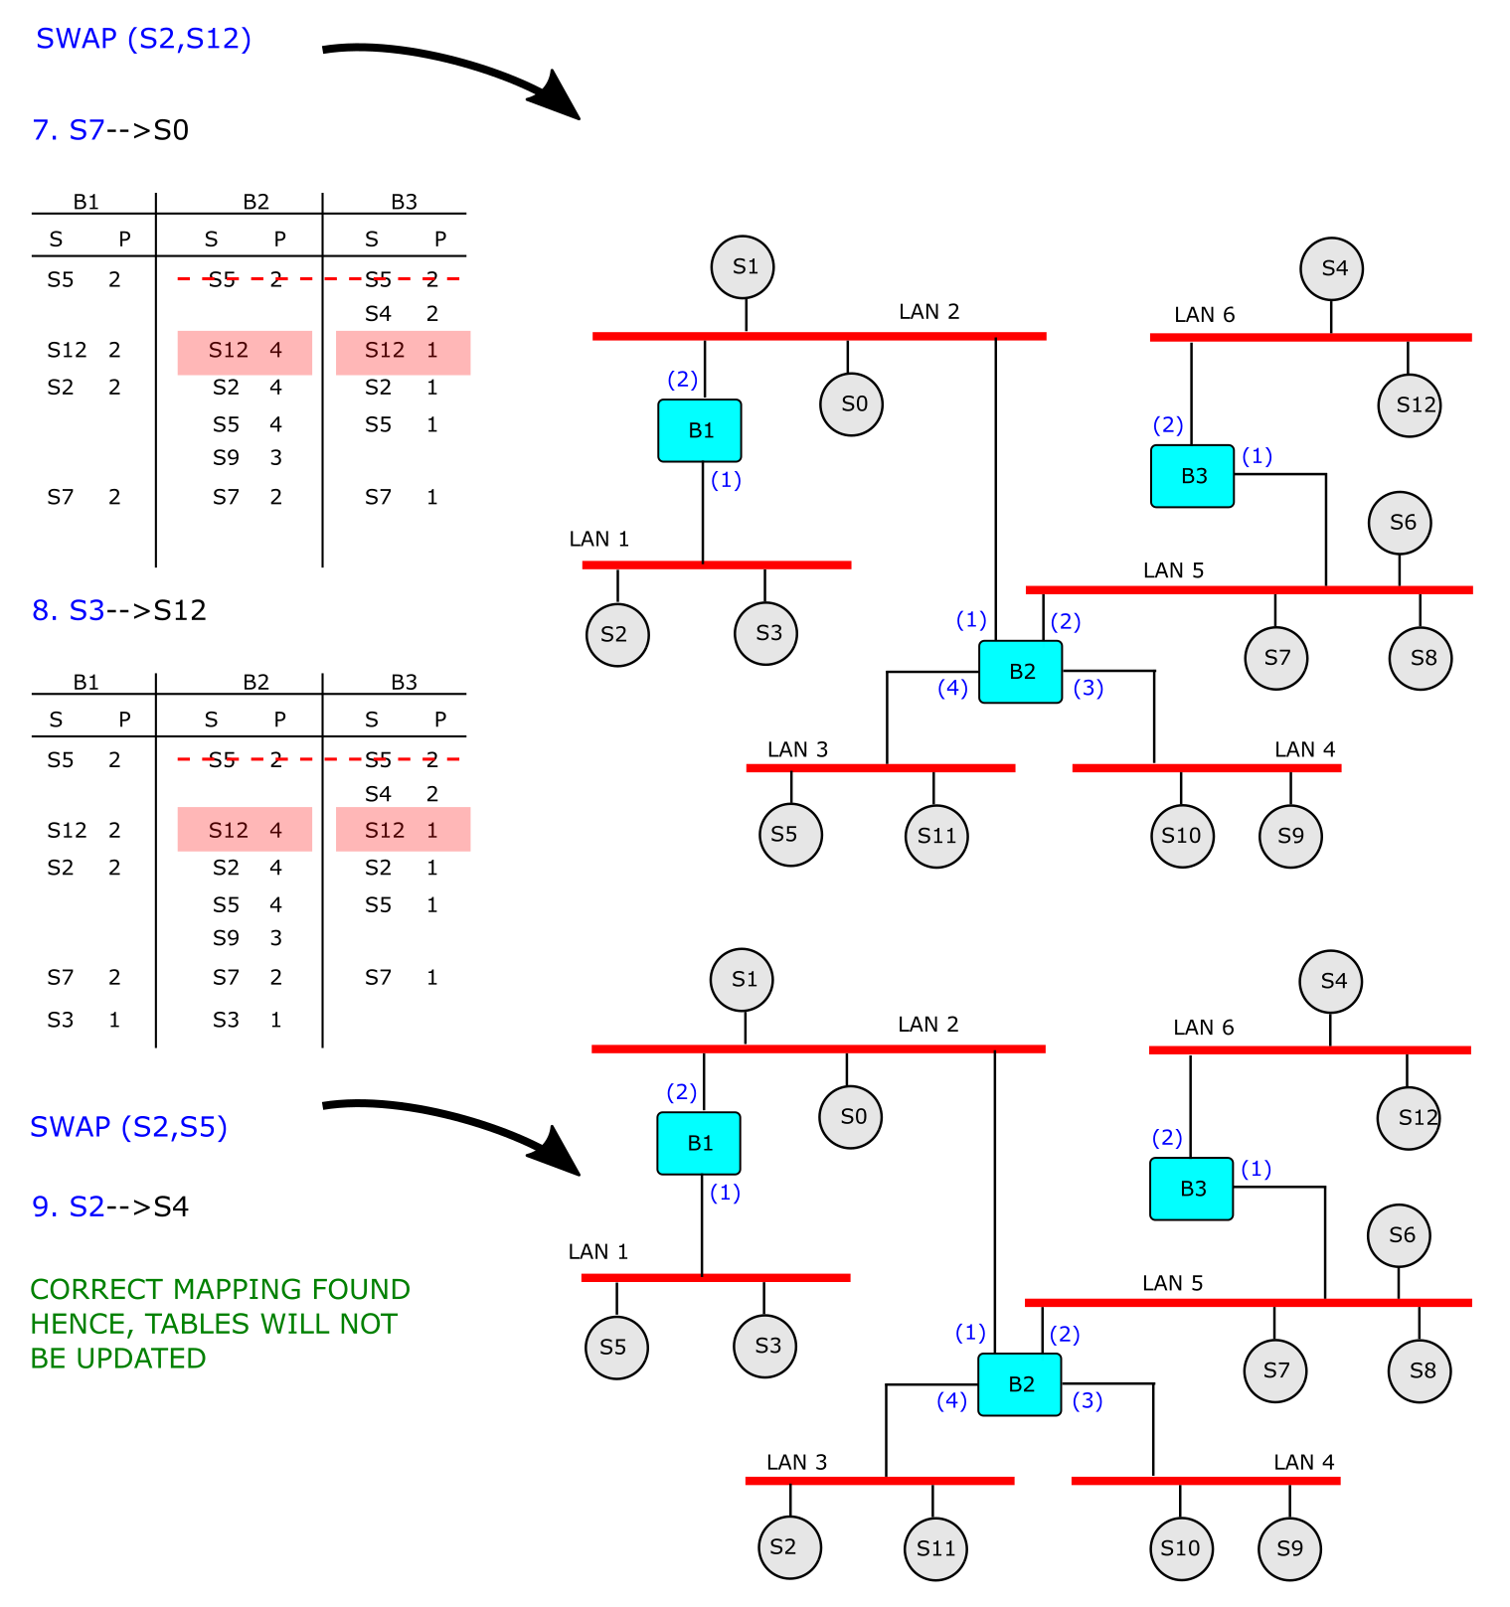

Slide 20
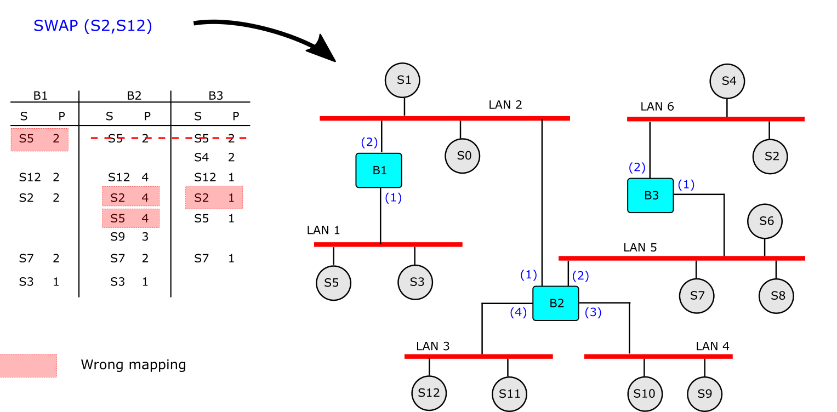

Slide 21
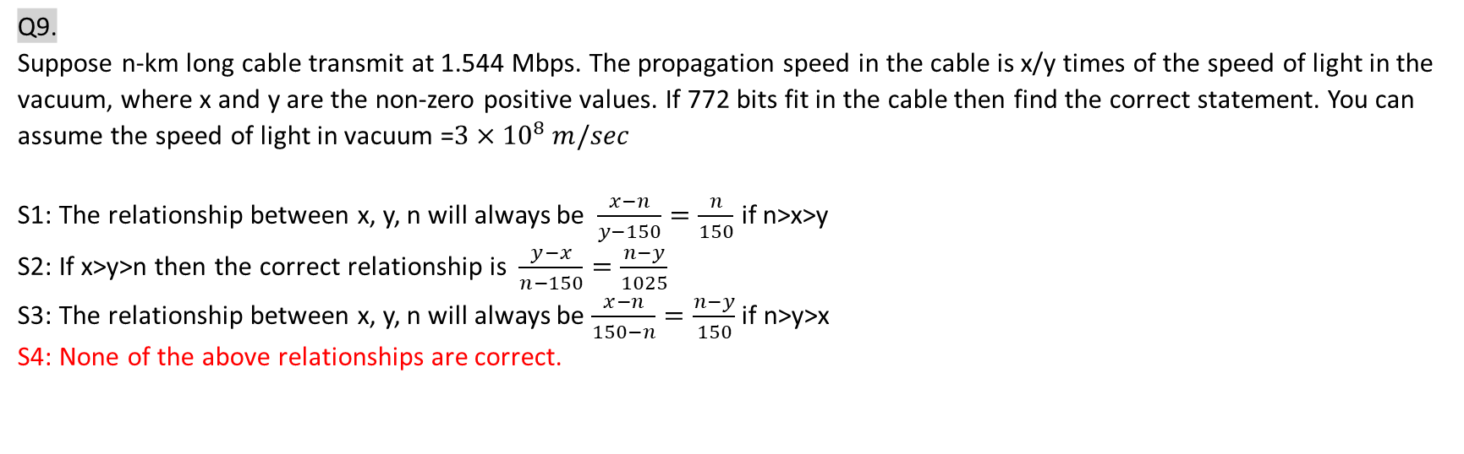
Q9. Suppose n-km long cable transmit at 1.544 Mbps. The propagation speed in the cable is x/y times of the speed of light in the vacuum, where x and y are the non-zero positive values. If 772 bits fit in the cable then find the correct statement. You can assume the speed of light in vacuum =$3×{10}^{8} m/sec$ S1: The relationship between x, y, n will always be $\frac{x−n}{y−150}=\frac{n}{150}$ if n>x>y S2: If x>y>n then the correct relationship is $\frac{y−x}{n−150}=\frac{n−y}{1025}$ S3: The relationship between x, y, n will always be $\frac{x−n}{150−n}=\frac{n−y}{150}$ if n>y>x S4: None of the above relationships are correct.
Options
Only S1
Only S2
Only S3
S4

Slide 22

Solution:
Data rate = 1.544 Mbps
Cable length = n km = $n×{10}^{3}$ m/sec
Speed of light in vacuum = $3×{10}^{8}m/sec$
Propagation speed = $\frac{3x}{y}×{10}^{8} m/sec$
Propagation delay = $\frac{n×1000}{\frac{3x}{y}×{10}^{8}}=\frac{ny}{3x}×{10}^{−5}sec$
Hence, $772=1.544×{10}^{6}×\frac{ny}{3x}×{10}^{−5}$ = $\frac{15.44×ny}{3x}$
$\frac{x}{y}=\frac{n}{150}$
$\frac{x−n}{y−150}=\frac{n}{150}$

Slide 23
Q10: Suppose an Ethernet address appear on the line in binary as follows (arrow denotes the direction of frame movement): Assume the following MAC address appears on the line in base 2 representation (arrow indicates direction in which the data moves): <-- 010110001101010000111100110100100111101011110110 Find the MAC address in Hexadecimal.
Options:
85:4D:C3:2D:A7:6F
1A:2B:3C:AD:5E:7F
6F:5E:AD:3C:2B:1A
None of the above

Slide 24
Solution:
The address is sent left to right, byte by byte; for each byte, it is sent right to left, bit by bit.
Hence, Correct Ans: 1A:2B:3C:AD:5E:6F

Slide 25

Q11: For the minimum length Ethernet frame, assume R is the percentage of relevant data to the full packet. Which one of the following is more accurate?
Options:
$0.71875=R$
$0.98814≥R$
$0.71875≥R$
$0.98814=R$

Slide 26
Solution:

Slide 27
Q12: If, in the case of Bluetooth, each device changes its modulation frequency 1600 times per second, i.e., Bluetooth hops 1600 times per second. Find the time used in hopping for frame exchange. State true/false: “There are no problems (except the cost) if we replace a bridge with a router”.
Options:
259 micro sec, True
259 micro sec, False
366 micro sec, True
None of the above

Slide 28
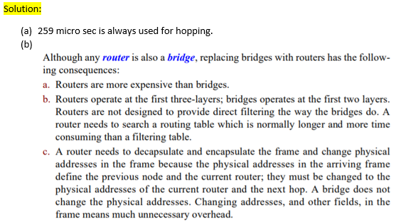

Slide 29
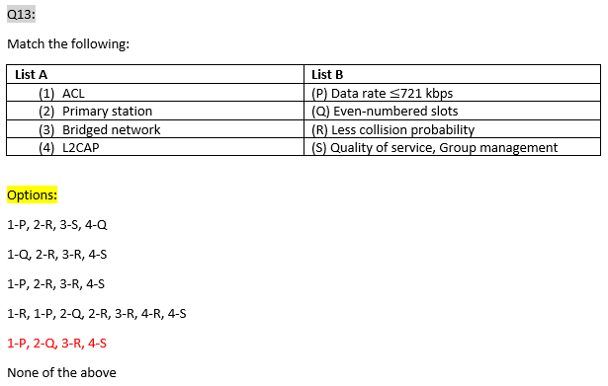

Slide 30
Solution:
Primary station sends on the even-numbered slots; the secondary sends on the odd-numbered slots.
ACL can use one, three, or more slots and can achieve a maximum data rate of 721 kbps
Adv. Of bridge is the separation of collision domain. In the bridged network the collision domain becomes much smaller and the probability of collision is reduced.
L2CAP has specific duties: multiplexing, segmentation and reassembly, QoS, group management, etc.

Slide 31
Q14. State true (T) or false (F) (P): Optical fibre supports higher bandwidth than coaxial cable (Q): Installation is a difficult task for optical fibre (R) Fibre optic is bi-directional (S) Minimum data size (without padding) in the standard Ethernet is 46 bytes.
Options:
(P)-T, (Q)-T, (R)-F, (S)- T
(P)-T, (Q)-T, (R)-F, (S)-F
(P)-T, (Q)-F, (R)-F, (S)- F
(P)T-, (Q)-F, (R)-F, (S)- T
None of the above

Slide 32
Q15. A slotted ALOHA network transmits 145-bit frames using a shared channel with a 145-kbps bandwidth. The system (all stations together) produces 250 frames per second. (a) Find the throughput of the system. (b) How many of 250 frames will probably survive.
Options:
0.195, 48
0.195, 49
0.303, 75
None of the above

Slide 33
Solution:
G=0.25
Throughput=0.1947
No of frames survived =0.1947*250=48.67

